Slide 1
On Covert Channels using QUIC Protocol Headers
David Cheeseman, CISSP

Slide 2
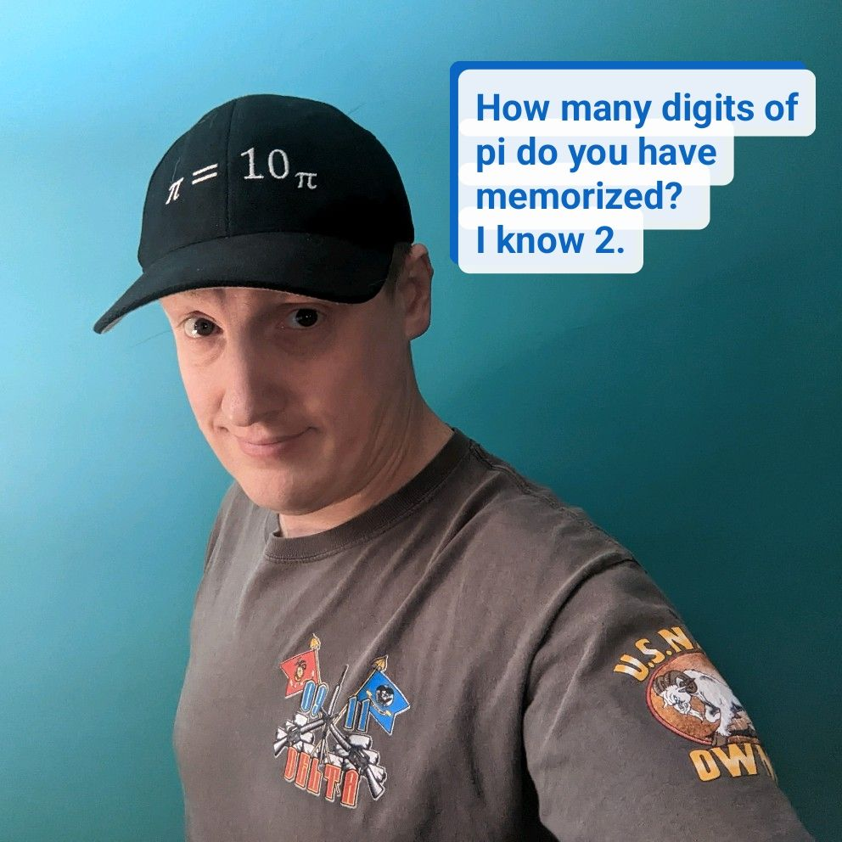
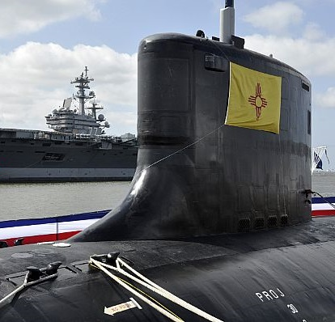
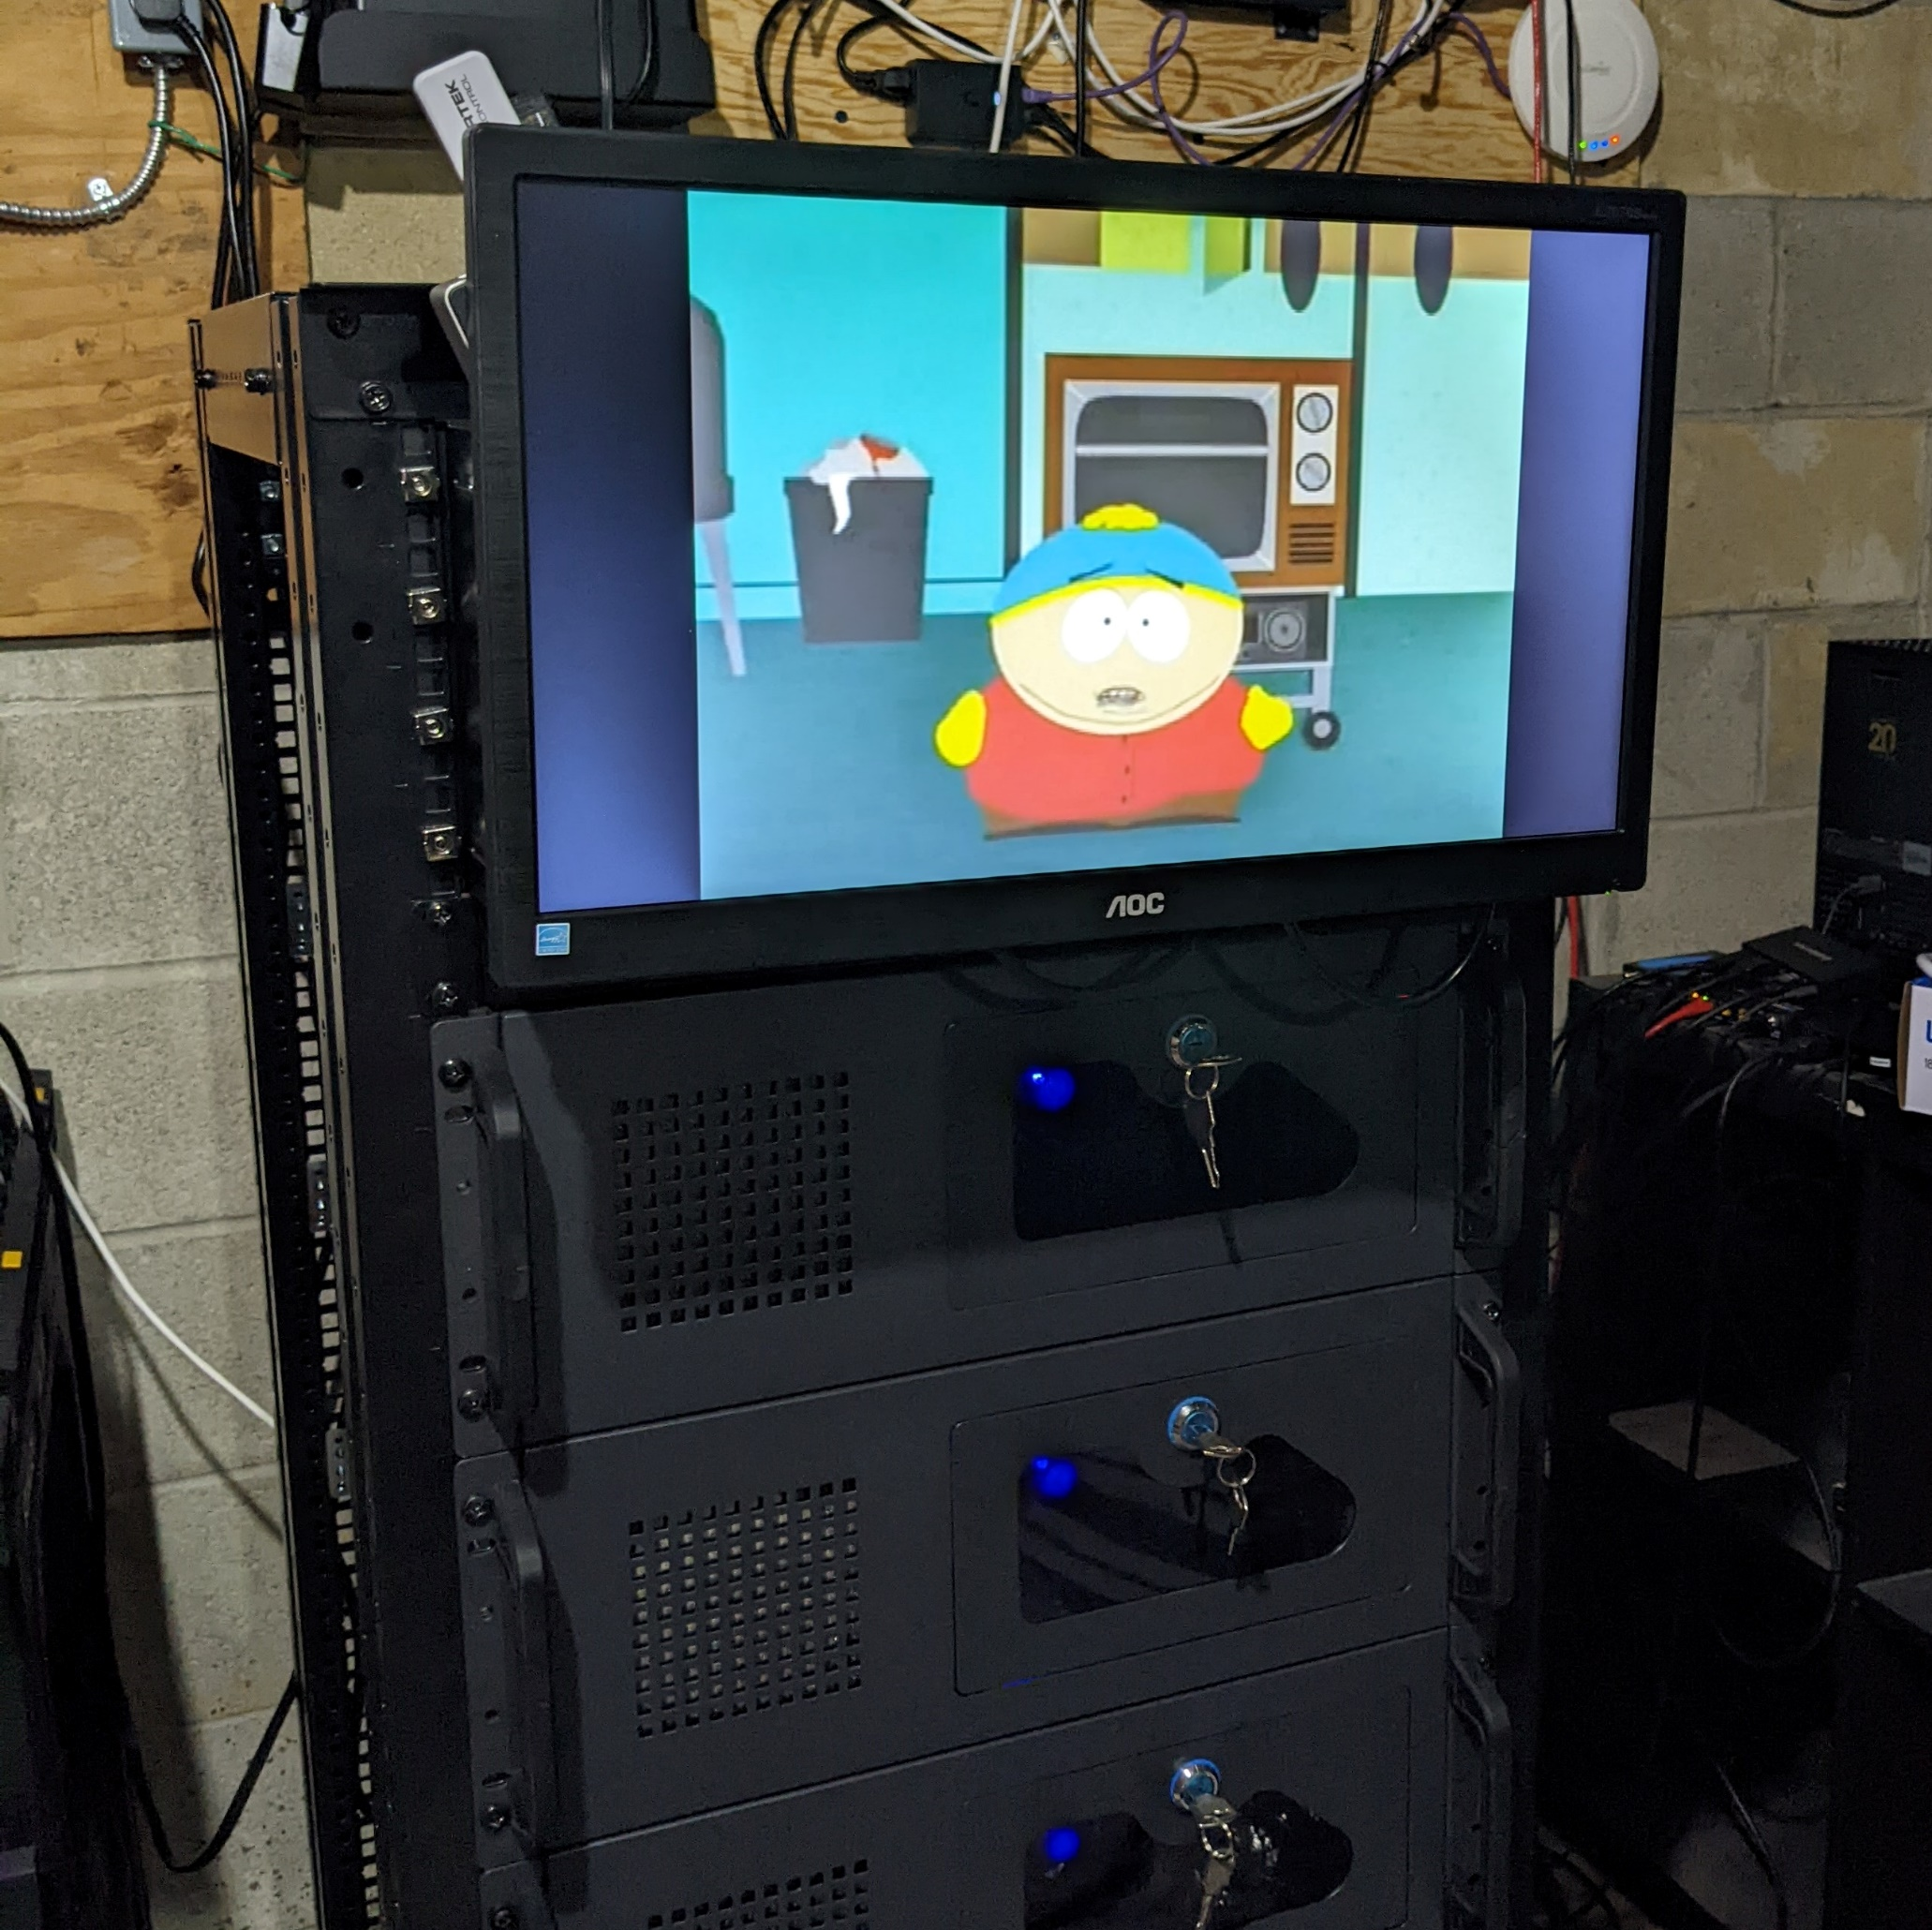
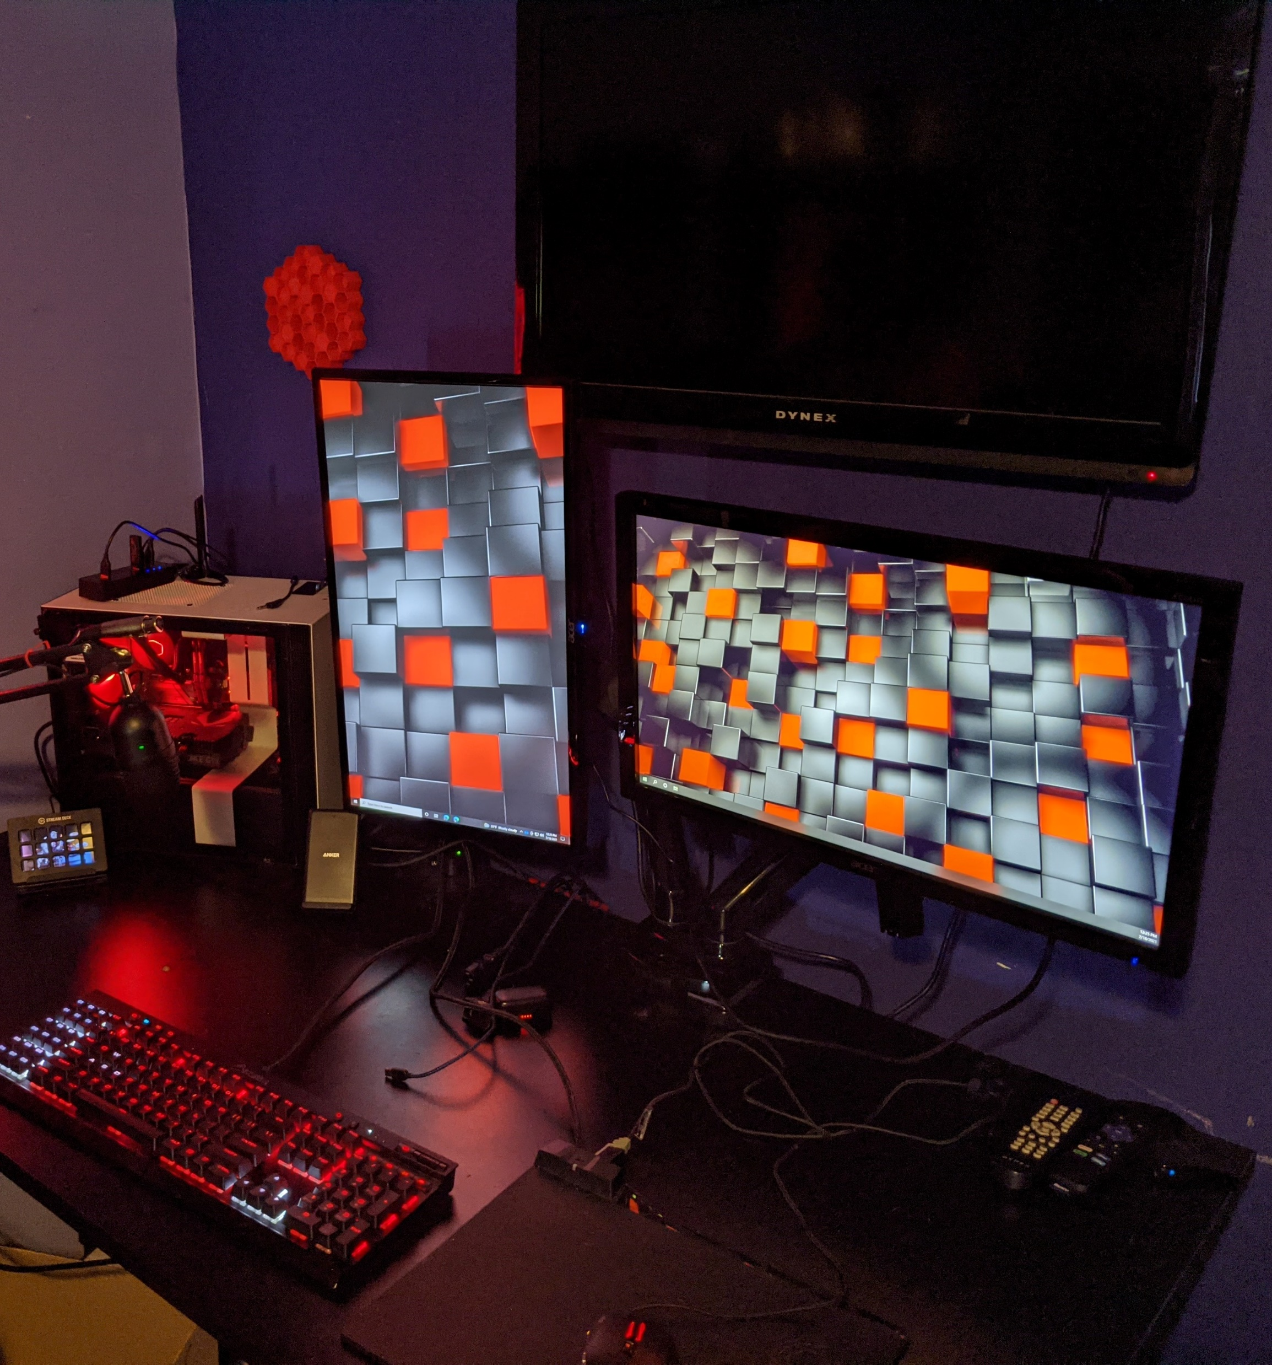
Introduction
Master Student at JHU
Cybersecurity Professional
Blue/Purple Team
US Navy Veteran
Submarine and Information Professional Officer
Hacker
Security Tool Development
CTFs
Science/Skepticism Enthusiast
Home Lab Enthusiast
Gamer
Maker

Slide 3
Overview
What is a Covert Channel?
Definition/Classification
Types of Covert Channels
Evaluation of Risk
What is the QUIC protocol?
How I “Built It!”
How I “Evaluated/Dunning-Kreuger it!”
References
Demo

Slide 4
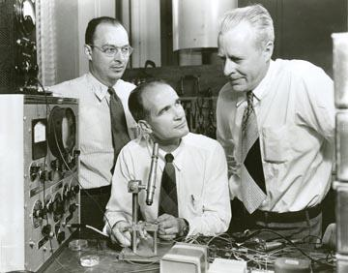

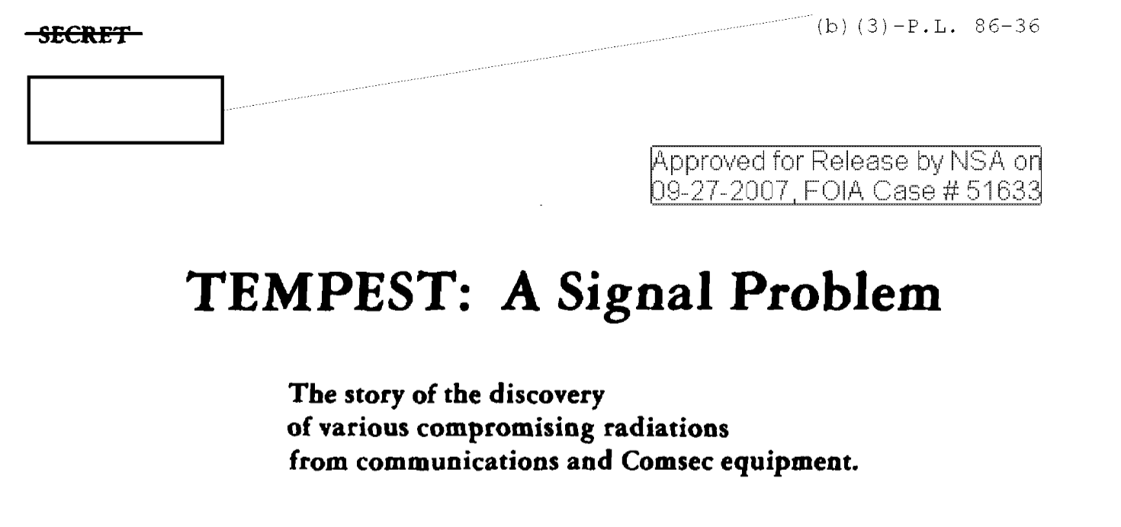
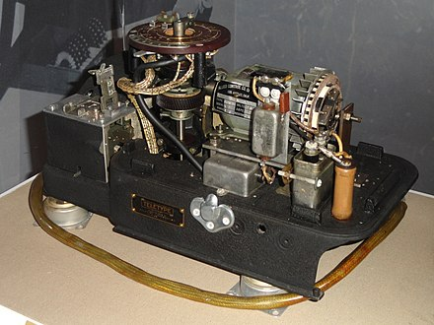
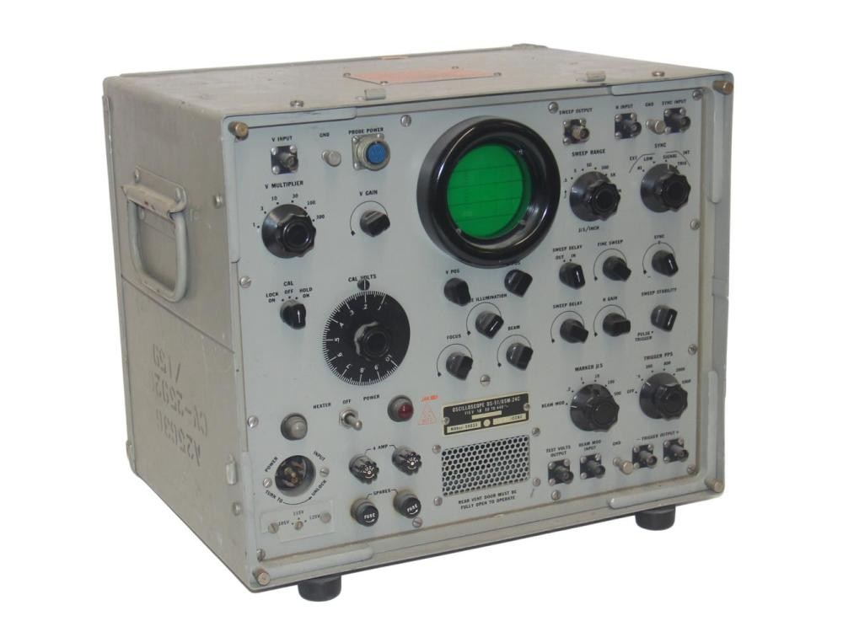


What is a Covert Channel?
Confinement Problem [1]
Prisoner’s Problem [2]
Bell Lab Researcher
Wendell (Warden)
SIGTOT
Oscilloscope
Alice
Bob
EM Leakage
Covert Channel
Notes:
Talk about the “why” in this slide.
Image Refs
https://www.invaluable.com/auction-lot/wwii-u-s-navy-oscilloscope-os-51-usm-24c-103-c-3bb498e920
https://westviewnews.org/2013/08/01/bell-labs-the-war-years/gcapsis/
https://en.wikipedia.org/wiki/SIGTOT

Slide 5
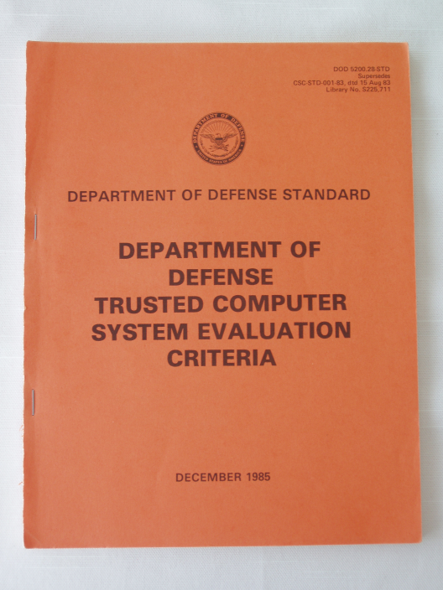
What is a Covert Channel?
How to evaluate a covert channel?
TCSEC [7]
IEEE Publications
Classification
Storage vs Timing
Risk
Bandwidth
Measured in Symbols or Bits/sec
Higher Worse
100 bits/sec considered “High”
Classification, Okhravi, et. al. [8]
Storage vs Timing
Network vs OS vs Hardware
Value vs Transition
Risk, Wang, et. al. [9]
Bandwidth
Weighted Difference
Threat Rate
Threat Degree
Notes:
Bandwidth – a function of leakage rate over time
Weight Difference – the sensitivity of the data
Threat Rate – the risk of the channel at a specific time
Threat degree – the risk of the channel over a period of time

Slide 6
BUILD IT (Covert Channel)!
6 Easy Steps
Pick a protocol
Find out if it’s been done before
Find a vector in the protocol
Implement communication in that vector
Test/Evaluate it
Notes:
Why did I do this?
Passion for encryption
Exploration in this class
Assignment due in 2 weeks

Slide 7
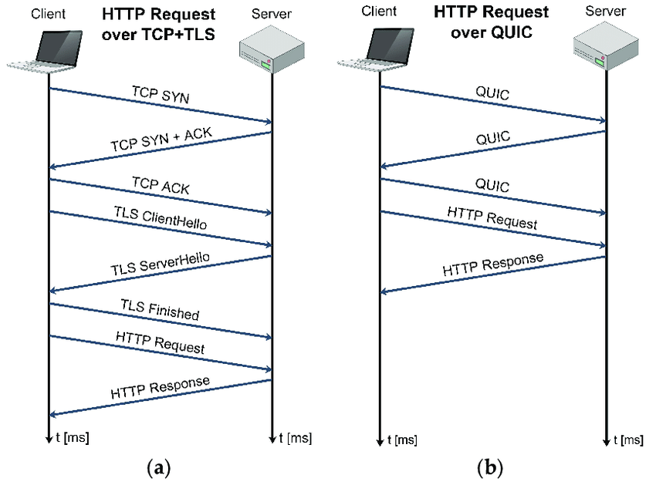
Pick a Protocol
Quick UDP Internet Connections
Proposed by Jim Roskind [5]
Defined in RFC 9000 [6]
QUIC is not an acronym
(but sure looks like one)
Supports ALPN
Combines handshake and encryption in a single step
Reduces Round-Trip-Time (RTT)
Multiplexes multiple streams over a single connection
Built-In congestion control
[5]

Slide 8
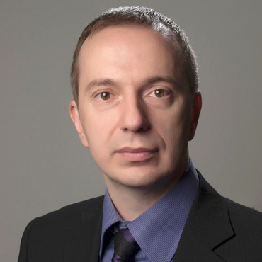
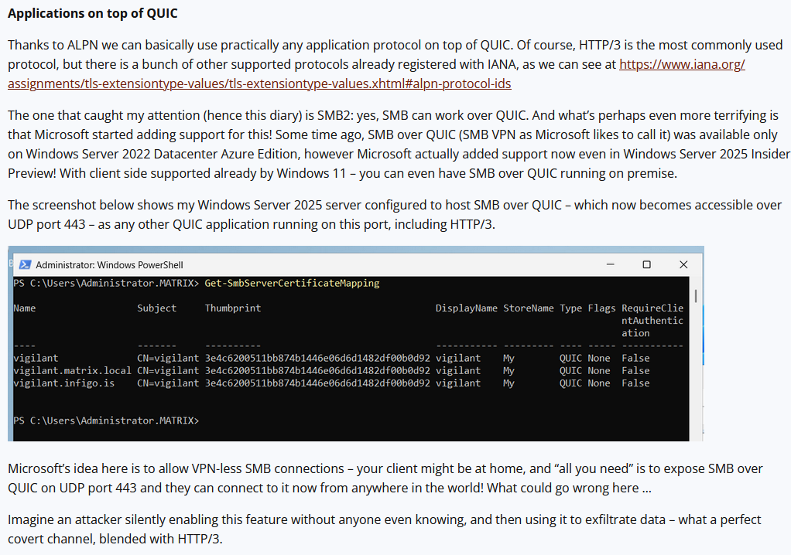
How to craft a Covert Channel
Are there existing QUIC Covert Channel Implementations?
Scanning and abusing the QUIC protocol
Author: Bojan Zdrnja
Discussed QUIC and its ALPN functions
Discussed challenges in enumerating QUIC ALPN services
Discussed Using SMB over QUIC to exfiltrate on trusted ports
Provided tool to scan QUIC services

Slide 9
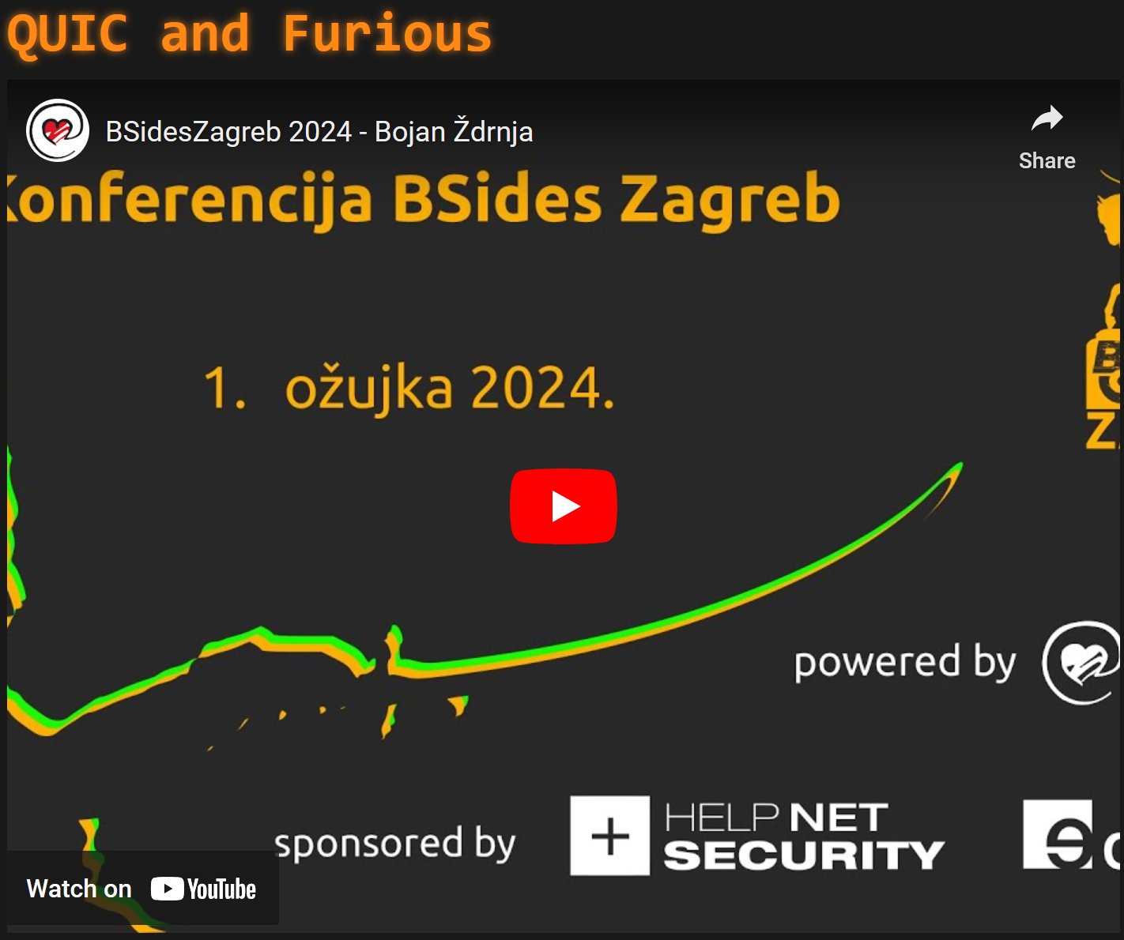



Bsides Zagreb 2024 https://www.bsideszagreb.com/archive-2024/#2
Quic and Furious Presentation on YouTube https://www.youtube.com/watch?v=BDg7KPS9AUg
Worried about QR Codes? Download Trend Micro’s QR Scanner for Android.

Slide 10
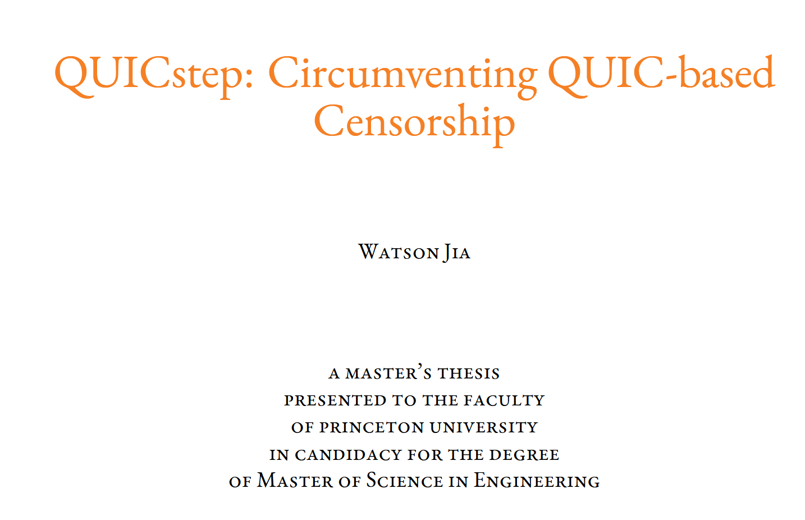

How to craft a Covert Channel
Are there existing QUIC Covert Channel Implementations?
https://www.proquest.com/openview/25eab1a97397cf68286005435eccd03d/1
Worried about QR Codes? Download Trend Micro’s QR Scanner for Android.
Notes:
Shoutout to Cooper Quintin and Will Greenberg for mentioning

Slide 11
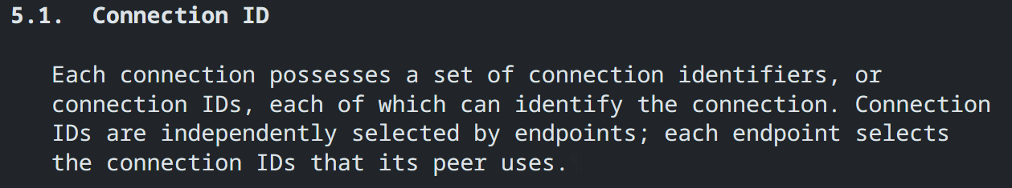
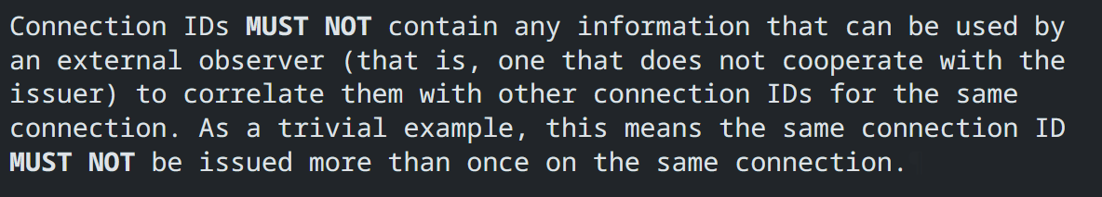
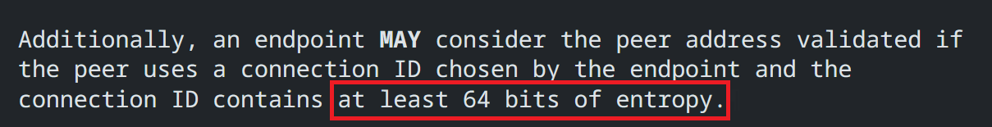
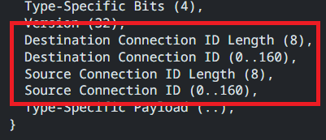
How to craft a Covert Channel
Find a vector in the protocol
Optional/Unstructured data
Timing channels
High entropy
Unique IDs
Nonce’s
GREAT FOR ENCRYPTED PAYLOADS!
Notes:
Entropy of n vs public bytes
Indistinguishable from benign traffic

Slide 12
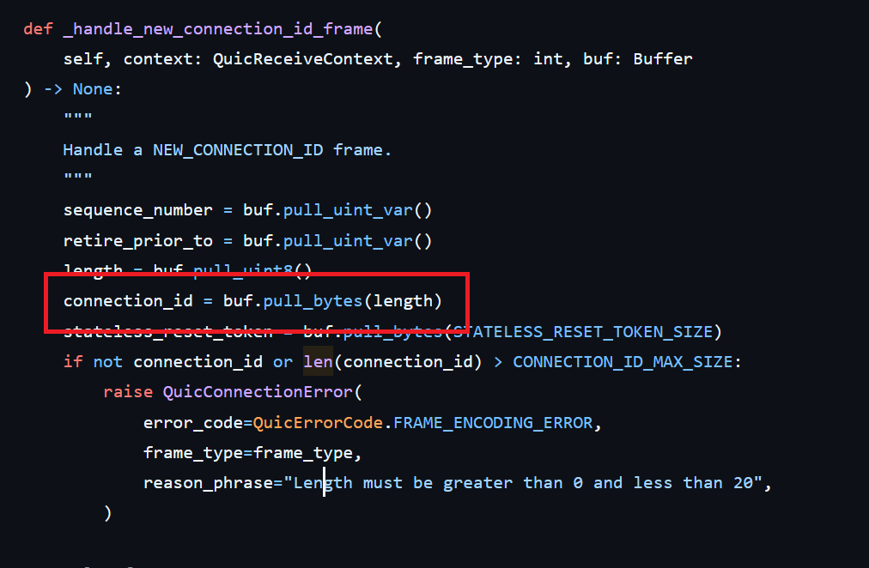
How to craft a Covert Channel
Implementing the Channel
src/aioquic/quic/connection.py
Write/Reuse Implementation
https://github.com/aiortc/aioquic
Find where target field is set
Find how it is potentially tracked or modified
Plan a protocol
Reverse Shell
Protocol Tunneling (Quic over Quic?)
Custom
(if you have a 2-week deadline)

Slide 13
How to craft a Covert Channel
Implementing the Channel – CID Queue
Message format:
m[message]
f[file bytes]
c[remote command]
k (keepalive)
Messages are queued and processed as connections are made
RSA 4096 for Asymmetric Encryption
Only public modulus exchanged
Public exponent/bit strength agreed to ahead of time
CID Generation
Create IV
Create an AES Key
Encrypt AES Key w/Private Key (Ekey)
Encrypt Message w/AES Key (Emsg)
Payload = IV + Ekey + Emsg
Chunk into 64-bit chunks
Use chunks as CIDs for new connections

Slide 14
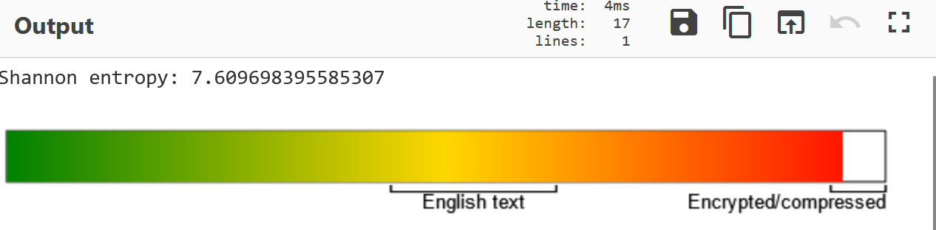
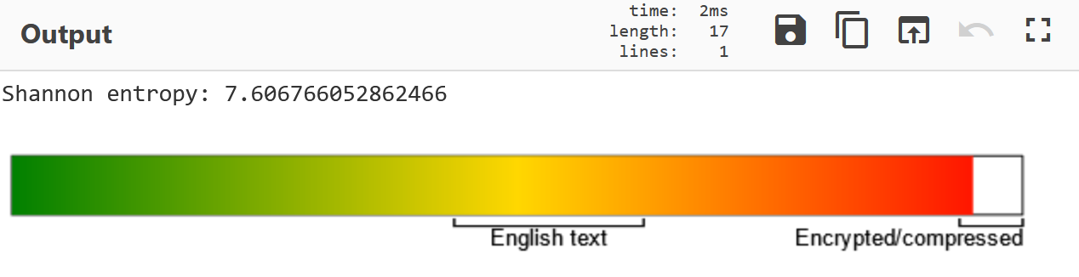
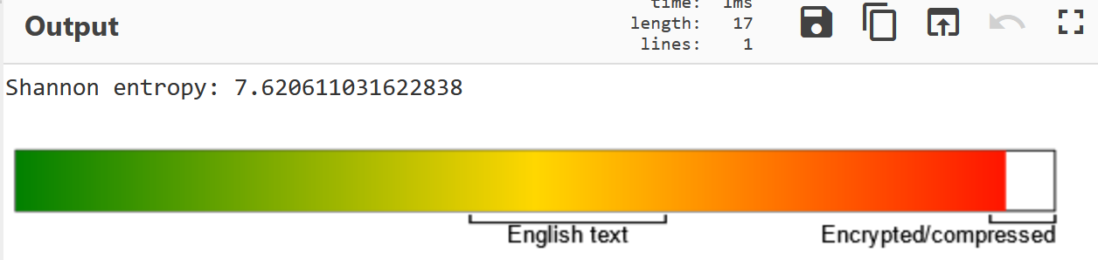
How to craft a Covert Channel
Entropy Random vs Public Modulus vs AES
Random: 7.610 bits/byte
RSA N Value: 7.607 bits/byte
AES: 7.621 bits/byte
Notes:
Entropy of n vs public bytes
Indistinguishable from benign traffic

Slide 15
User Operations
cwhoami
CID Queue
Server
Client
CID Queue
CID
CID
Modified aioquic operations.
Public Key
k
k
k
k
k
Public Key
mnuvious

Slide 16
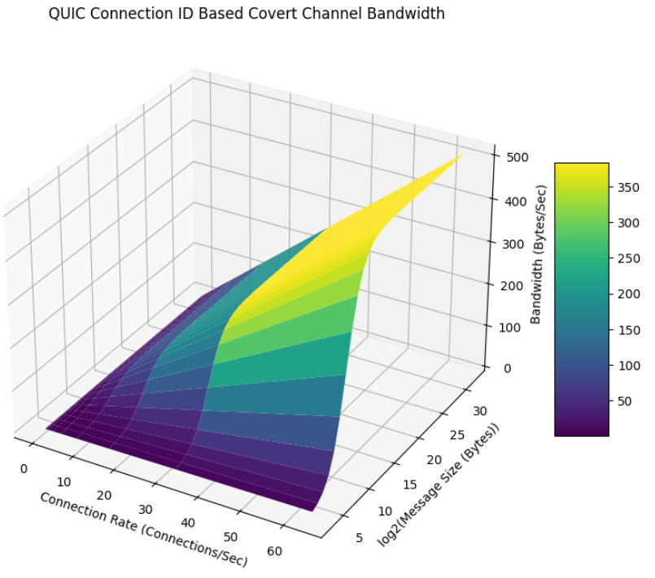
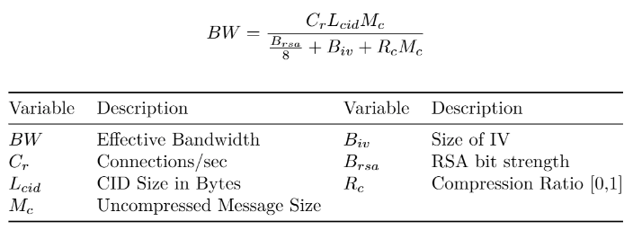
How to craft a Covert Channel
Evaluating the Channel – Bandwidth
Notes:
Talk about axis

Slide 17
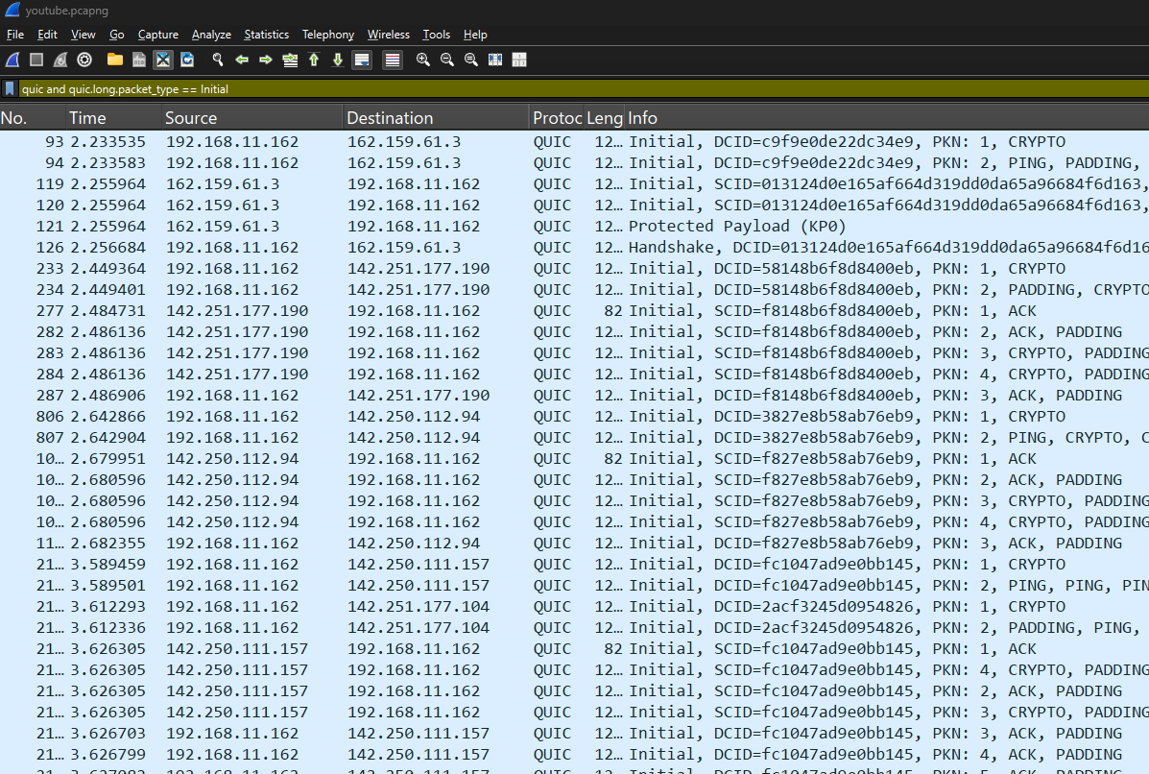

How to craft a Covert Channel
Implementing the Channel – Page Loads to Extract 4096 Bit RSA Private Key
C_{r} | 21 con / 8 sec
L_{cid} | 64 bits
M_{c} | 4096 bits
B_{iv} | 128 bits
B_{rsa} | 4096 bits
R_{c} | 1 (uncompressed)
BW | 10.3 byte/sec
Time | 49.5 sec
21 Connections with 64- and 160-bit CIDs
Notes:
Time to exfiltrate rsa private key

Slide 18
How to craft a Covert Channel
Improvement for the Implementation
Observation
Odd-number analysis potentially reveals channel in use
Randomize big vs little endian potential mitigation
Moot if OOB key distribution is used
Manipulation
Potentially susceptible to bit-flip attacks if message format is disclosed
Key exchange could be intercepted providing a MITM attack vector
Disruption
Swapping out CID’s on all QUIC protocol packets would stop this channel
Costly
Dropping connections randomly to prevent 1 CID exchange would break cryptographic sync
Could be mitigated by creating cryptographic resync mechanism
Other Improvements
Support out-of-order reception
More robust confidentiality/integrity checking
MUST NOT INTRODUCE LOW ENTORPY SIGNAL!

Slide 19
Final Thoughts
High Entropy Fields + Encryption = Nearly Impossible to Detect
Endpoint protection DLP controls are a must.
Just BUILD IT! Even if it’s been done before.
Don’t just build it, DOCUMENT IT!
Every job I’ve gotten was showing off what I’ve built.
Have a (healthy) skepticism of your own work.

Slide 20
References
[1] B. W. Lampson, “A note on the confinement problem,” Communications of the ACM, vol. 16, no. 10, pp. 613–615, Oct. 1973, doi: https://doi.org/10.1145/362375.362389
[2] G. J. Simmons, “The Prisoners’ Problem and the Subliminal Channel,” Advances in Cryptology, pp. 51–67, 1984, doi: https://doi.org/10.1007/978-1-4684-4730-9_5
[3] National Security Agency, “TEMPEST: A Signal Problem.” Available: https://www.nsa.gov/portals/75/documents/news-features/declassified-documents/cryptologic-spectrum/tempest.pdf. [Accessed: Dec. 10, 2024]
[4] J. Lorincz, Z. Klarin, and J. Ozegovic, “A Comprehensive Overview of TCP Congestion Control in 5G Networks: Research Challenges and Future Perspectives,” Sensors, vol. 21, pp. 1–41, Jun. 2021, doi: https://doi.org/10.3390/s21134510
[5]A. Langley et al., “The QUIC transport protocol: Design and internet-scale deployment,” 2017.
[6] J. Iyengar and M. Thomson, “RFC 9000 - QUIC: A UDP-Based Multiplexed and Secure Transport,” datatracker.ietf.org, May 2021. Available: https://datatracker.ietf.org/doc/html/rfc9000. [Accessed: Dec. 10, 2024]
[7] Trusted Computer System Evaluation Criteria. DoD, 1985. Available: https://csrc.nist.gov/files/pubs/conference/1998/10/08/proceedings-of-the-21st-nissc-1998/final/docs/early-cs-papers/dod85.pdf
[8] N. C. Wang and N. S. Ju, “The new criteria for covert channels auditing,” IEEE, vol. 15, pp. 183–186, Jun. 2005, doi: https://doi.org/10.1109/iaw.2004.1437815. Available: https://ieeexplore.ieee.org/document/1437815. [Accessed: Dec. 13, 2024]
[9] H. Okhravi, S. Bak, and S. T. King, “Design, implementation and evaluation of covert channel attacks,” in 2010 IEEE International Conference on Technologies for Homeland Security (HST), pp. 481–487. doi: https://doi.org/10.1109/THS.2010.5654967
[10] B. Zdrnja, “Scanning and abusing the QUIC protocol - SANS Internet Storm Center,” SANS Internet Storm Center, 2024. Available: https://isc.sans.edu/diary/30720. [Accessed: Dec. 31, 2024]
[11] B. Zdrnja, “quicmap/README.md at main · bojanisc/quicmap,” GitHub, 2024. Available: https://github.com/bojanisc/quicmap/blob/main/README.md. [Accessed: Dec. 31, 2024]
[12]B. Zdrnja, “BSidesZagreb 2024 - Bojan Ždrnja,” YouTube, Mar. 23, 2024. Available: https://www.youtube.com/watch?v=BDg7KPS9AUg. [Accessed: Jan. 08, 2025]

Slide 21
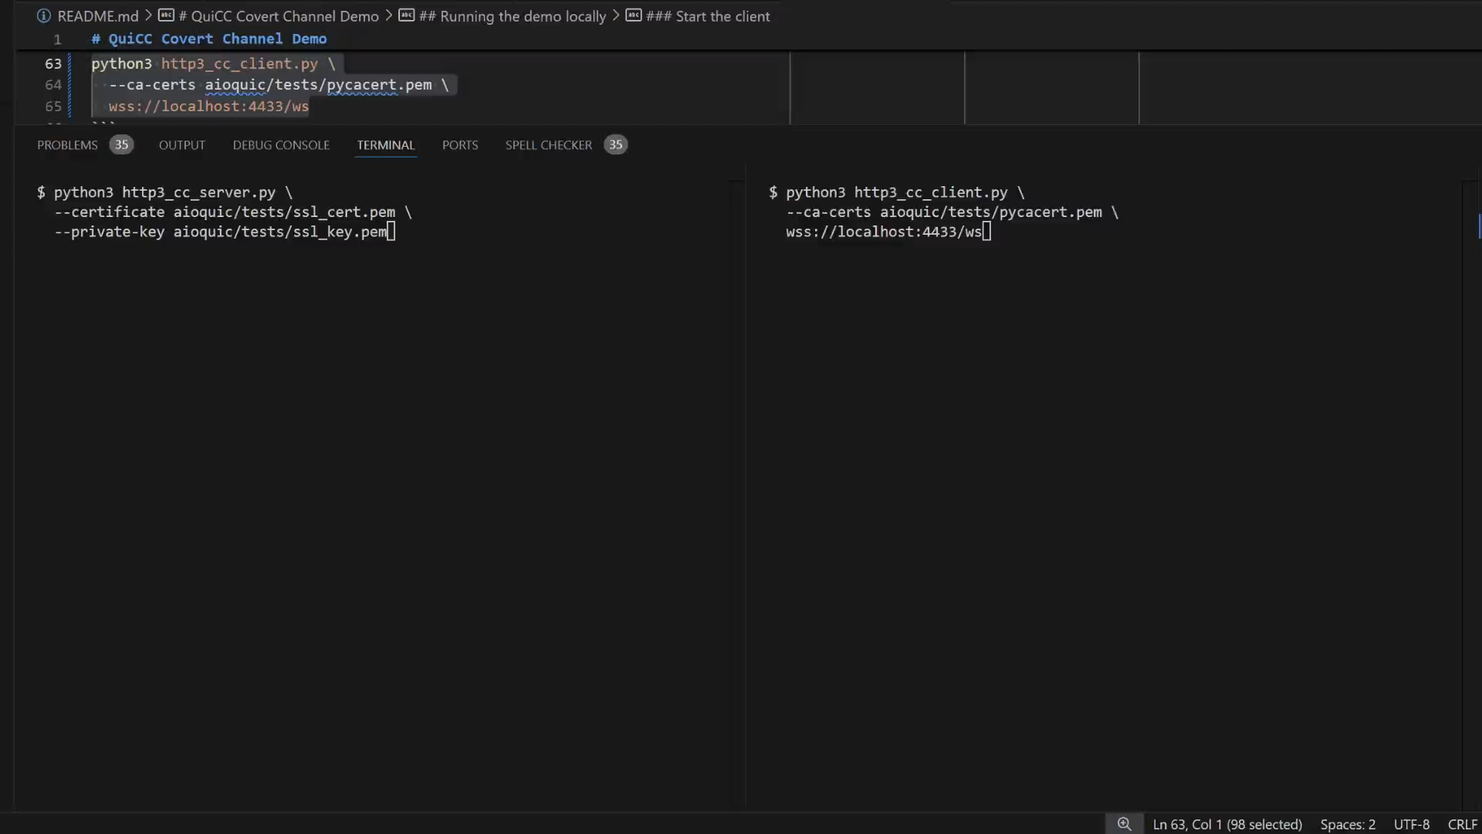
Demo
Notes:
Don’t just “Build It!”
Document it!
Dunning Kreuger it!

